Slide 1
Prediction of near- term climate change impacts on UK wheat quality and the potential for adaptation through plant breeding
Nick S Fradgley, James Bacon, Alison R Bentley, Germano Costa-Neto, Andrew Cottrell, Jose Crossa, Jaime Cuevas, Matthew Kerton, Edward Pope, Stéphanie M Swarbreck, Keith A Gardner.
JOURNAL CLUB: Brayden Blanchard, Flavia Furlan and Maria Montiel
AGRI 7057 Prediction Based Breeding

Slide 2
General overview
Combining quantitative genetics with climate model outputs, we investigated UK- wide trends in genotypic adaptation for wheat quality traits.
Addition of environmental covariates, such as temperature and rainfall, successfully enabled prediction of genotype by environment interactions (G × E), and increased prediction accuracy of most traits for new genotypes in new year cross validation.

Slide 3
Introduction
How to anticipate the effects on grain quality?
Which environmental changes are predictable?
Climate change impacts
Is it possible to breed varieties that are resilient to those changes?

Slide 4
Objectives of this study
Determine the overall effects of predicted trends in climate change on the UK wheat quality using enviromics-based genomic predictions methods and climate model projections.
Quantify the potential for breeding to mitigate adverse effects of year-to-year environmental variation by exploiting predictable G x E.

Slide 5
Methods
Data:
240 genotypes
20 years of trials for 392 year/location “environments
Phenotypic information for
specific weight
protein content
gluten strength
degree of starch breakdown
Genetic markers and pedigree data
Characterization of Trial Environments using environmental covariables for soil and weather
Strategy:
1. Genomic prediction models
2. Predict the G x E and explain the variation in the data set.
3. Predict the quality performance of wheat genotypes in future projected environments

Slide 6
Methods – Multi environmental trial data
392 wheat variety field trial environments (year/location combinations) in the UK spanning 20 years
(average trials/year = 20.47)
Quality traits:
Grain protein content (%)
Hagberg falling number (HFN; seconds)
Specific weight (kg hl−1)
Gluten quality traits
Zeleny sedimentation volume
Chopin alveograph W and P/L values
Genotype occurrence in each environment: unbalanced.
Groups of related genotypes: balanced.
Notes:
Figure 1: Spatial, temporal and genetic structure of material in the field trials dataset. (a) Locations of the 392 trial environments across
the UK. Point size and colour indicate the number of years of trials at that location. Map lines delineate study areas and do not necessarily
depict accepted national boundaries. (b) Dendrogram indicating pedigree- based kinship for the 240 genotypes included and (c) their
occurrences in trials each year.

Slide 7

Methods – Envirotyping and enviromic relationship matrix
Trial – environments
ENVIROTYPING
Environmental covariables (ECs):
Weather information
Soil properties (texture, soil organic carbon, etc.)
Past trial data and future projections
Creating the Enviromic Relationship Matrix (ERM):
EC matrix = q environments × k environmental covariates.
EC matrix → scaled and mean centered.
EC matrix computes ERM of q environments x q environments
Monthly average ECs, in the crop season for winter wheat
The ERM describes the similarities among pairs of field trials across years (Gaussian kernel). Dim: n env. x n env.
Notes:
where w is the scaled EC matrix, !w−w"!2 is the Euclidean Distance
between each element of the EC matrix (n environments × m ECs),
! is a scaling factor assumed as the mean value of the Euclidean
distance matrix and h is a bandwidth factor which was assumed
to be 1 as default. The ERM therefore had dimensions of n environments
× n environments. T

Slide 8
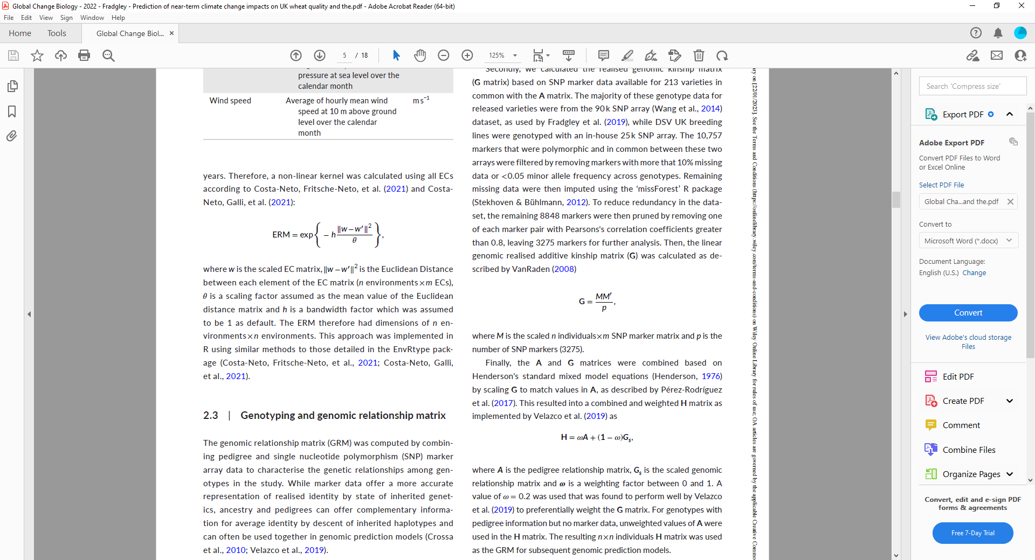
Methods – Genotyping and genomic relationship matrix
Pedigree data and SNP marker array
GRM: genomic relationship matrix
Pedigree-based kinship Matrix (A). Dim n genotypes x n genotypes.
Genomic kinship Matrix (G): 10,757 polymorphic markers → QC
**USED AS THE GRM MATRIX FOR PREDICTION MODELS
A and G matrices are combined into the H matrix. Dim n individuals x n individuals
Notes:
where A is the pedigree relationship matrix, Gs is the scaled genomic
relationship matrix and ! is a weighting factor between 0 and 1.

Slide 9

Methods – Genetic and environmental correlations
Is there any common genetic and environmental influence among traits?
Correlations between pairs of traits to deal with unbalanced data
Phenotypic values of each trait (t) for each genotype (n)
n x t
Intercept vector
Vector of the mean of each trait
Error
Random genetic effects considering
incidence of different cultivars
GRM
variance-covariance matrix of genetic effects between traits
Random environmental effects considering
incidence of different environments
ERM
variance-covariance matrix of environmental effects between traits

Slide 10
Methods – Prediction Models
Phenotypic prediction across years
MODELS
MM: Main genetic effects; includes random environmental effects and GRM
MDs: added the G x E interaction term (multi-environment, single variance G × E deviation model)
RNMM: extends MM to include the predictable interaction G x E term.
RNMDs: extends MD to include the predictable interaction G x E term and consider the G x E deviation and a reaction- norm structure.

Slide 11
Methods – Prediction Models Comparison
MM and MD
RNMM and RNMD
Uses random and unpredictable GxE in the observed environments and will make same predictions in untested environments
GRM + ERM of tested genotypes and environments
Uses EC data of untested environments to make more specific predictions according to predictable GxE

Slide 12
Methods –Model quality assessment
Leave- one-year out cross validation for untested genotypes in untested years (as the genotypes are unbalanced in every environment)
Pearson correlation coefficient: between mean values of observed and out of fold predicted trait values per year.
Predictive accuracy of quality traits for each trial by environment (Pearson correlation) between observed and out of fold prediction.
Mean and median for each model

Slide 13
Methods – Projection of future climate effects
RNMM models were fitted
All past observed data (pheno and env.)
A total of 68,280 genotype – environment combination were predicted for each of the traits.
Predict phenotypes for 20 randomly selected wheat variety genotypes UNDER:
Past conditions
Future conditions

Slide 14
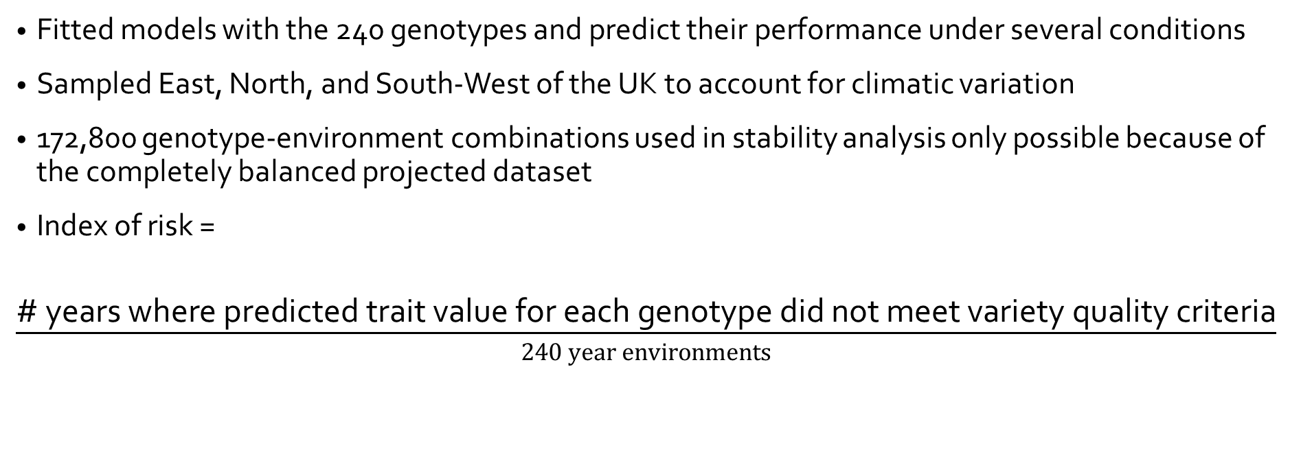
Methods – Prediction of trait stability across projected future year- to- year environmental variation
Fitted models with the 240 genotypes and predict their performance under several conditions
Sampled East, North, and South-West of the UK to account for climatic variation
172,800 genotype-environment combinations used in stability analysis only possible because of the completely balanced projected dataset
Index of risk =
$\frac{\text{\# }\text{years} \text{where} \text{predicted} \text{trait} \text{value} \text{for} \text{each} \text{genotype} \text{did} \text{not} \text{meet} \text{variety} \text{quality} \text{criteria}}{240 year environments}$

Slide 15
Methods – Assessment of specific weather variable effects on quality
Challenge: confounding effects of genotype and geographic location of observed data
Solution: Machine learning (random forest) and Correlation analysis
Weather variable importance and direction

Slide 16
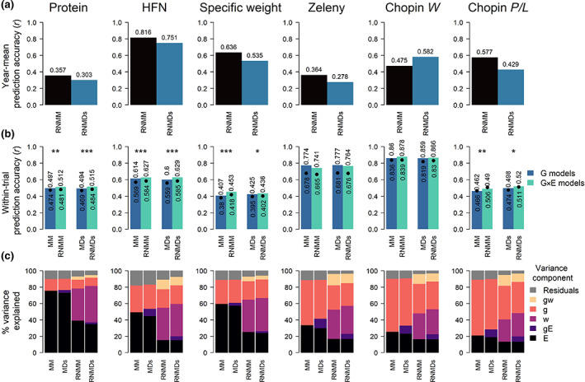
Results Environmental covariates enable prediction of G x E
Notes:
FIGURE 2 Models including environmental covariate improve the prediction accuracy for wheat quality traits. (a) Comparison of
prediction accuracy (correlation between observed and predicted data) of mean trait values for each trial year for both reaction norm
models (RNMM and RNMDs) that incorporate environmental covariates into models for each quality trait. HFN, Hagberg Falling number.
(b) Comparison of cross- validated within- trial genomic prediction accuracy between genetic models (MM and MDs) that use only genetic
data and equivalent reaction norm models (RNMM and RNMDs) for untested genotypes in untested years cross- validation. Bars indicate
median while black points indicate the mean prediction accuracy across all trial environments. Median and mean values are also shown
above and below bars and points respectively. Statistical significance level between means from paired t- tests are shown above each pair
of G and G × E prediction model comparisons where *p < .05, **p < .01, and ***p < .001. (c) Percentages of the phenotypic variation explained
by each variance component for each prediction model for all traits. Variance components are described in the methods where E indicates
the random effect of environment, gE indicates the interaction between genotype and the random environmental effect, w indicates
the predictable environmental effect that can be explained by weather and soil environmental covariates, g indicates the genetic effect
estimated from markers and gw indicates the predictable interaction between g and w.

Slide 17
Results: Predicted effects of climate change on wheat quality traits are different across UK regions
Notes:
Overview of projected changes in UK summer and winter climate. Comparison of climatological average rainfall and
temperature patterns in (a) January, and (b) July across the UK at 12 km grid square resolution between the observed average climate
between 2000 and 2019 (derived from the HadUK- grid weather dataset) and projected future climate conditions between 2050 and 2069
(derived from the bias corrected UKCP18 climate projections dataset and averaged across all 12 ensemble members). Map lines delineate
study areas and do not necessarily depict accepted national boundaries.

Slide 18
Results: Associated weather covariables explain contrasting climate change effects across UK regions

Slide 19
Results: Predictions of G x E responses suggest little potential for breeding to mitigate effects of year-to-year environmental variability

Slide 20
Discussion
Results showed positive effects of climate change on key quality traits in some regions that are not currently suited to growing high quality wheat
Presents opportunity for expansion of production area of high-quality wheat to mitigate the negative impacts in the current production areas
Limited potential for breeding to exploit predictable GxE and produce varieties that are resilient to year-to-year climate variability for all traits except for HFN
Results indicate that differing environmental challenges in different regions will present a need for localized breeding rather than broad adaptation of the UK
Including environmental covariates provided modest but significant increases in prediction capabilities of models
Robust cross validation strategies are complimentary to the unbalanced nature of historical datasets

Slide 21
Learning from this Review

Slide 22
Citation
Fradgley, N. S., Bacon, J., Bentley, A. R., Costa-Neto, G., Cottrell, A., Crossa, J., Cuevas, J., Kerton, M., Pope, E., Swarbreck, S. M., & Gardner, K. A. (2023). Prediction of near-term climate change impacts on UK wheat quality and the potential for adaptation through plant breeding. Global change biology, 29(5), 1296–1313. https://doi.org/10.1111/gcb.16552

